Slide 1
The Byzantine General Problem
Leslie Lamport, Robert Shostak, Marshall Pease. SRI International
presented by Muyuan Wang
Notes:
Hi everyone, the paper byzantine general problem I am going present today is done by Leslie lamport, robert shostak, marshall pease from SRI international.

Slide 2
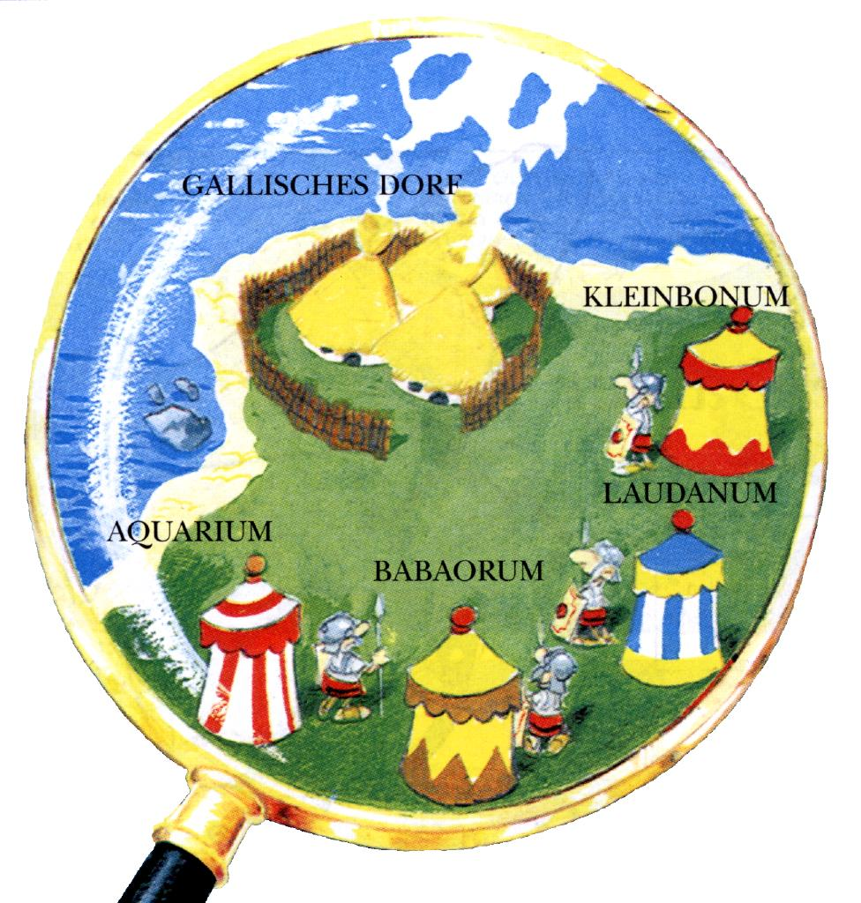
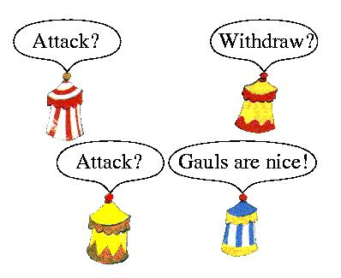
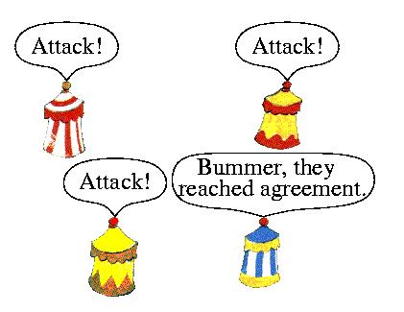
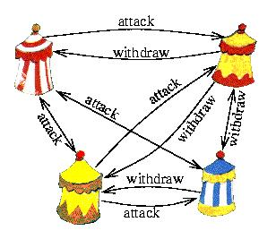
Once upon a time...
Some of them may be traitors who will try to confuse the others
  Communicating only by messenger
  Generals must agree upon a common battle plan
The pictures are taken from: R. Goscinny and A. Uderzo, Asterix and Latraviata.
Notes:
The Background of this problem is as this. once upon a time, Byzantine troops are going to attack a village of Gauls. A group of generals of the Byzantine army camped with their troops around an enemy city.
They communicate with each other only by messenger. They must agree upon a common battle plan, but some of them may be traitors who will try to confuse the others

Slide 3
Byzantine Generals Problem & Impossible Results
Find an algorithm
  To ensure that the loyal generals will reach agreement
  A small number of traitors cannot cause the loyal generals to adopt a bad plan
Remodeled as a commanding general sending an order to his lieutenants
  IC1: All loyal generals get same result
  IC2: If commander is loyal, all loyal generals follow his choice
No solution will work unless there are more than 2/3 loyal ones
Notes:
And here comes our task. We want to find an algorithm to ensure that the loyal generals will reach agreement. At the same time, we hope that a small number of traitors will not cause the loyal generals to adopt a bad plan.
For easy description, the Byzantine generals problems can be modeled as this: we are required to satisfy the two so called ‘interactive consistency’ conditions IC one and IC two. The first one is, all loyal generals will get the same result; the second one is, if the commander is loyal, then all loyal generals will follow his choice.

Slide 4


Example: Poor Lieutenant 1’s Dilemma
Attack
Commander
Attack
He said retreat
Lieutenant 1
Lieutenant 2 (Traitor)
Attack
Commander (Traitor)
Retreat
IC1 violated !
The two situations
are identical to me!
He said retreat
Lieutenant 1
Lieutenant 2
Attack
Retreat
Notes:
Let’s look at an example with only 3 generals. The upper picture shows a possible situation where one of the lieutenants, lieutenant 2 is traitor. The commander sends an attack message to both lieutenants, however, since lieutenant 2 is traitor, he told lieutenant 1 that, the commander said retreat. So, for lieutenant 1, he gets two different messages from the commander and the lieutenant now. Which one should he trust? Is there a good strategy for him? Let’s consider another case shown in the right figure. Here the commander is a traitor while lieutenant 2 is loyal. The commander send attack to lieutenant 1 while retreat to lieutenant 2. Lieutenant 2 is loyal, so he told lieutenant 1 that the commander said retreat. Notice that, for lieutenant 1, these two situations are exactly the same, he has no information to distinguish these two. Thus, whatever strategy he uses, he must get the same decision under these two cases. He cannot tell who is the traitor, so In order to satisfy the IC2, he must obey the commander’s order, whatever the other lieutenant said. For Lieutenant 2, it is similar. So Lieutenant 1 will attack but lieutenant 2 will retreat. Then IC1 is violated!

Slide 5
Solutions
Solution 1: Using Oral Messages
Solution 2: Using Signed Messages

Slide 6
Solution using Oral Message
Solution for more than 3m+1 generals with m traitors
Oral messages:
  Every message that is sent is delivered correctly
  The receiver of a message knows who sent it
  The absence of a message can be detected
Function 'majority':
  With the property that if a majority of the values v_{i} equals v, then majority(v₁,...,v_{n-1}) equals v.
Order set V_{i}
  Each lieutenant uses it to store orders from others
Algorithm OM(m) can deal with m traitors
  Defined recursively
Notes:
Although we have no idea to deal with traitors more than 1/3 of the generals, however, using oral messages, we can give a solution to the byzantine general problem for more than 3m+1 generals with m traitors.
What is an oral message? First, every message that is sent is delivered correctly; second, the receiver of a message knows who sent it; and third, the absence of a message can be detected.
In other words, the contents of an oral message are fully controlled by the sender, and so a traitor can send any kind of message.
In order to make a decision we also need the majority function. The majority funcition, as the name implies, is function that applies majority voting. It has the property that if…….
With these tools, we have an algorithm OM(m) that can deal with m traitors. This algorithm is defined recursively. Now we are trying to describe it.

Slide 7
Base case: OM(0)
Commander 0
Commander sends messages to Lieutenants
Each Lieutenant receives and records it.
attack
attack
attack
Lieutenant i
Lieutenant j
Lieutenant k
V_{i} ={v₀:attack}
V_{i} ={v₀:attack}
V_{i} ={v₀:attack}
Notes:
First let’s look at the base case. In the base case, the commander sends message to each Lieutenant. Here we illustrate the situation that the commander is loyal. Remember that the commander need not to be loyal.
For each lieutenant, what he need to do is to add the order into his order set. As shown in the figure.

Slide 8
OM(m)
Commander
Each Lieutenant act as the commander in OM(m-1)
Send messages to ‘his’ Lieutenants
Do this recursively
attack
attack
attack
attack
attack
……
Lieutenant i
Lieutenant j
Lieutenant k
attack
Notes:
What happens in the general case? For each Lieutenant, when he gets a value from the commander, he sends it to all the other lieutenants. This action is repeated recursively. That is, the lieutenant i receives an order from the commander, records it, and then, in this round he will play as the commander to the other n-2 lieutenants. And the same thing happens to lieuntenant i+1, which will play the commander role in the execution of OM(m-2). Until we reach the base case, the next round begins.

Slide 9
Step 3: Majority Vote
Commander
For any m, Algorithm OM(m) satisfies conditions IC1 and IC2 if there are more than 3m generals and at most m traitors
My decision is:
majority(v1,v2,…,v_n-1)
Me too
Me too
……
Lieutenant 1
Lieutenant 2
Lieutenant n-1
Notes:
After all the Lieutenants have sent their values and got others’ value, they can make a decision using majority vote based on their information vector. Since there are

Slide 10
OM(1): Lieutenant 3 is a traitor
Commander
IC1 achieved
IC2 achieved
Attack
Attack
Majority(attack,attack,attack)
=attack
Attack
Majority(attack,attack,retreat)
=attack
Attack
Attack
Attack
Retreat
Lieutenant 1
Lieutenant 2
Lieutenant 3 (Traitor)
Attack
Attack
Notes:
This figure illustrates the messages received by lieutenant 2 when the commander sends the value v and lieutenant 3 is a traitor. In the first step,

Slide 11
OM(1): Commander is a traitor
Commander (Traitor)
IC1 achieved
IC2 need not be satisfied
Attack
Retreat
Retreat
Majority(attack,retreat,retreat)
=retreat
Majority(attack,retreat,retreat)
=retreat
Majority(attack,retreat,retreat)
=retreat
Attack
Retreat
Retreat
Retreat
Lieutenant 1
Lieutenant 2
Lieutenant 3
Attack
Retreat

Slide 12
Solution with Signed Messages
What is a signed message?
  A loyal general's signature cannot be forged, and any alteration of the contents of his signed messages can be detected
  Anyone can verify the authenticity of a general's signature
Function choice(V): decision making
  If the set V consists of the single element v, then choice(V)=v
Note: no other characteristics needed for choice(V)
Notes:
Are there any better answers? Well, if we enable the use of signed messages, the situation will be better. Before describing the algorithm, we must know what a signed message means. Each signed message has at least the sender’s signatures on it, and a loyal general’s signature cannot be forged, and any alteration of the contents of the signed messages can be detected. Also, anyone can verify the authenticity of a general’s signature.
We also need a function ‘choice’ to make a decision based on the input information. The function only needs to satisfy two conditions: first, if the set V consists of the single element v, then choice V equals v. Second, choice emptyset equals retreat. No other characteristics are needed.

Slide 13
Step 1
Commander sends message to each Lieutenant
For any Lieutenant i, if he receives the v:0 message and he has not received any order yet
  Let V_{i}={v}
  Send v:0:i to other lieutenants
Commander (Traitor)
retreat:0
attack:0
attack:0
V_{j}={attack}
V_{j}={attack,attack}
attack:0:i
Lieutenant j
attack:0:i
Lieutenant i
Lieutenant k
V_{k}={retreat}
V_{i}={attack}
V_{k}={retreat,attack}
Notes:
With these specifications, we can solve the problem better. In the first step, the commander sends his signed message to all the lieutenants. For any Lieutenant i, if he receives the v colon zero message, and he has not received any order yet, then he will let vi equals set of v, and send message v colon zero colon I to other lieutenants

Slide 14
Step 2
If Lieutenant i receives a message of v:0:j₁:…:j_{k}, and v is NOT in set V_{i}, then
  Add v to V_{i}
  If k<m, send v:0:j₁:…:j_{k}:i to every lieutenant except j₁,…,j_{k}
When any Lieutenant i will receive no more messages
  Make decision using choice(V_{i})
Commander (Traitor)
retreat:0
Attack:0
Attack:0
V_{j}={attack,attack,retreat}
They get
the same order set!
V_{i}=V_{j}=V_{k}
Lieutenant j
Lieutenant k
V_{k}={attack,attack,retreat}
Lieutenant i
V_{i}={attack,attack,retreat}
Notes:
With these specifications, we can solve the problem better. In the first step, the commander sends his signed message to all the lieutenants. For any Lieutenant i, if he receives the v colon zero message, and he has not received any order yet, then he will let vi equals set of v, and send message v colon zero colon I to other lieutenants

Slide 15
Example
Commander (Traitor)
For any m, Algoritym SM(m) solves the Byzantine Generals Problem if there are at most m traitors.
The traitor can not cheat now!
Attack:0
Retreat:0
They get same information, thus same decision
Retreat:0:2
Lieutenant 1
Attack:0:1
Lieutenant 2
V1 = {Attack,Retreat}
V2 = {Attack,Retreat}

Slide 16
Conclusion
The requirements (Interactive Consistency Condition)
  IC1: All loyal generals get same result
  IC2: If commander is loyal, all loyal generals follow his choice
Theorems to remember:
  1. For any m, Algorithm OM(m) satisfies conditions IC1 and IC2 if there are more than 3m generals and at most m traitors
  2. For any m, Algorithm SM(m) solves the Byzantine Generals Problem if there are at most m traitors.

Slide 17
Discussions
These solutions are not used in practice
  Why?
What if the messages get lost a lot during communication?
Are there any other way besides ‘majority’ and ‘same information’?

